Slide 1

More stats … and posters
Prof. Andy Wills

Slide 2
Topic of today’s lecture
A bit more on statistics
+
Posters

Slide 3
Assumptions behind statistical tests
Both the Sign-test, and the Mann-Whitney test which condition tends to be associated with the highest scores.
They make no assumptions about the size of the differences, or how these data are distributed.
i.e. they only require that the data can be placed in a rank-order: i.e. ORDINAL data only.
(They can also be used for interval and ratio data, but not categorical data).

Slide 4
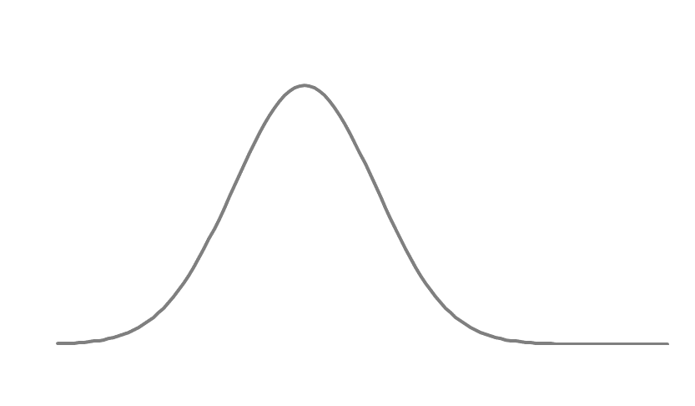
Non-Parametric vs Parametric tests
Statistical Tests that make no assumptions about the distribution of likely scores are called Non-parametric.
Other (more powerful) statistical tests rest upon assumptions about the underlying distribution of scores. These distributions (like the bell curve) can be described by mathematical parameters, and so these are called Parametric tests.
The larger the sample size, so the closer the distribution of coin-flips resembles a normal distribution (bell-curve). This is called Central Limit Theorem.
TTHH
THTH
THHH THHT HTTT
HTHH HTTH THTT
HHTH HTHT TTHT
HHHH HHHT HHTT TTHH TTTT

Slide 5
The Pearson correlation coefficient (r)
Is an example of a parametric test.
It assumes that the data are normally distributed (come from a bell-curve).
This is why correlation values are sensitive to odd distributions (e.g. outliers, gaps in the data etc).
If you are doing a correlational project, this is why I want you to present the distribution of data on your poster.

Slide 6
The size of a sample
Larger samples do not reduce the likelihood of making a Type 2 error (i.e. a false positive).
This is because significance is defined as the probability of an outcome happening by chance 5% of the time.
And that is determined (partly) by the sample size.
However, sample size does have an important effect (next slide)

Slide 7
Remember this: 4 coin flips
TTHH
THTH
THHH THHT HTTT
HTHH HTTH THTT
HHTH HTHT TTHT
HHHH HHHT HHTT TTTH TTTT
The chance of 4 Tails in a row is 1/16, or 6.25%.

Slide 8
Extending this to 5 vs 8 coin flips:

Slide 9
5 vs 8 coin flips:
For 8 flips, ONLY 7 have to be Tails to be significant
For 5 flips, ALL of them have to be Tails to be significant

Slide 10
Sample size and significance
For a sample size of 5, 5% significance is reached if 5/5 (= 100%) of trials show a TAIL.
For a sample size of 8, 5% significance is reached if 7/8 (=87.5%) of trials show a TAIL.
For a sample size of 12, 5% significance is reached if 9/12 (=75%) of trials show a TAIL.
Etc
i.e. larger sample sizes require less extreme differences (i.e. smaller effects) in order to show a significant difference.

Slide 11
Sample size and Power
Put another way, for any given size of effect, larger samples give you a greater likelihood of detecting it (if it exists).
i.e. if a coin is slightly biased (e.g. comes up Tails 60% of the time), you are more likely to detect this effect, the larger the sample you have.
The Power of a statistical test is the likelihood it will detect an effect of a given size (i.e. find a significant difference) if the effect really exists.

Slide 12
Sample size, effect size, significance
Sample size
Bigger (vs smaller) sample sizes:
Enable the detection of smaller effect sizes.
For a given effect size, give lower estimates of probability by chance (i.e. more “significance”)
Statistical Significance
Effect size

Slide 13
Sample size, effect size, significance
Sample size
Statistical Significance
Effect size
Bigger (vs smaller) effect sizes:
For a given sample size, will lead to lower estimates occurrence by chance
For a given significance level, require a smaller sample to detect.

Slide 14
Sample size, effect size, significance
Sample size
The likelihood of detecting an effect by chance:
For a given sample size, is greater for higher p values (e.g. p = .05 vs p = .01).
For a given effect size, is greater for higher p values (e.g. p = .05 vs p = .01).
Statistical Significance
Effect size

Slide 15
Two issues to be aware of with “significance”.
1: More “significance” means “lower probability”.
We can set the criterion for significance at different points, depending upon how much we worry about a Type 2 error.
1 in 10 p = .10
1 in 20 p = .05
1 in 100 p = .01
1 in a 1000 p = .001
etc
As the probability of a chance finding decreases, so we are MORE likely to believe that a genuine difference exists.
Thus, scientists write about these values being MORE significant.

Slide 16
2: Significance does not mean importance
In statistical testing, significance means the likelihood an outcome could have occurred by chance.
It does not mean “importance”, as in the everyday use of the term.
e.g. a “significant event” means something important has happened.
The practical application of a finding is most often linked to the effect size (how big the difference is).

Slide 17
Significance vs practical importance
Sample size
For very large samples, very small (trivial) differences (or correlations) can be statistically significant; these may be of no practical value.
Larger samples are more able to detect smaller effects
Statistical Significance
Effect size

Slide 18
A signpost to the future.
So far, we have been discussing statistics that test the likelihood of an effect occurring by chance.
This is called Null Hypothesis Significance Testing (NHST).
This has been the dominant approach in Psychology for the past century, so you will read a lot of studies that use it.
However, more recently a new approach – called Bayesian analysis – is gaining support. You will learn about this later in your programme.

Slide 19
4 coin flips with a fair vs unfair coin.
A fair coin A double sided coin
TTHH
THTH
THHH THHT HTTT
HTHH HTTH THTT
HHTH HTHT TTHT
HHHH HHHT HHTT TTTH TTTT TTTT
The chance of 4 Tails in a row is 1/16 with a fair coin and 1/1 with a
double-sided coin.
i.e. finding TTTT is 16 times more likely with an unfair coin than a fair coin.

Slide 20
The general logic of a NHST vs Bayesian test
NHST – what is the likelihood of an observation by chance alone
Bayesian – what is the likelihood of an observation by chance vs a predicted outcome?

Slide 21
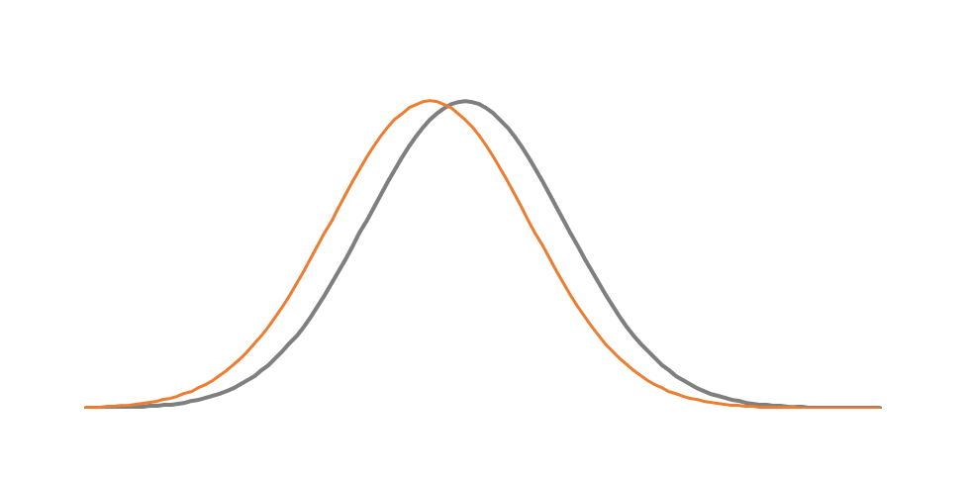
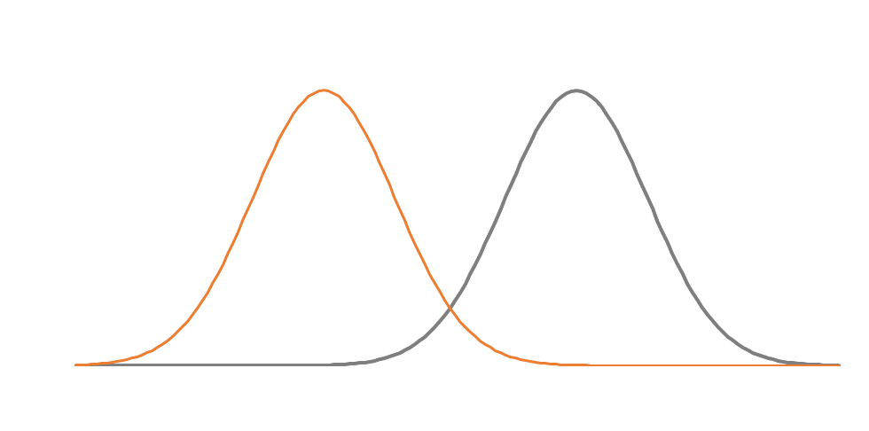
Bayesian statistics depend upon the predicted size of an effect.
A small difference is predicted
A large difference is predicted
Here the observation (red line) favours the grey distribution.
Here the same observation (red line) favours the orange distribution (because grey predicts MUCH higher).

Slide 22
Part 2: Posters
3 topics to cover:
1: What your poster should contain
2: What your poster should look like.
3: How do you make a poster? (continued in workshops)

Slide 23
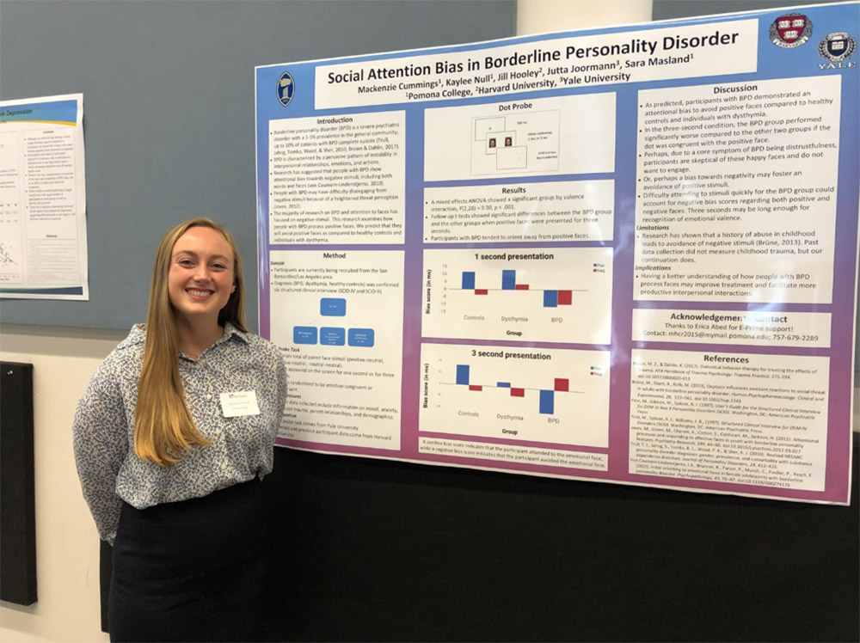
A scientific poster is…
A visual display of a science project for other scientists
Presented in a poster session during a conference
Supported by Q&A with the authors

Slide 24
The authors are expected to
Give a verbal summary of all aspects of the research
Answer specific questions (particularly about details not on the poster)
(You will do this as a GROUP).

Slide 25
A poster should be…
Engaging
Informative
Structured
Scientific
All for the benefit of a scientific audience
Achieved through
Aesthetics (visual appeal)
+
Scientific content
Backed up by authors in Q & A session

Slide 26
Part 1: The formal elements of a Poster
1: A title (visible from 2-3 metres)
- with a list of authors
2: Introduction
3: Method
4: Results
5: Discussion

Slide 27
The Title (and authorship)
Is the primary way to engage a potential audience.
It should be engaging and informative.
It should be visually appealing from a distance.
It should be accompanied by the list of authors.

Slide 28
For your poster: The Title (and authorship)
Your title should try to engage a scientific audience.
It should be informative:
i.e. NOT “Our group study”.
It should make the audience want to learn more
“A study of exercise and memory”
vs
“Does exercise boost memory performance?”
vs
“Can you jog your memory?”

Slide 29
For your poster: The Title (and authorship)
Your Title should appear at the top of your poster, large (and distinct enough) to be seen from about 3-4 metres.
A full list of authors (first name and surname) should appear beneath the poster.

Slide 30
Introduction
After reading your introduction the audience / reader should understand:
What is already known about the topic (i.e. the background literature).
How your study follows on from, or adds to, this knowledge.
What you plan to do.
What you expect to find (your hypothesis).

Slide 31
For your poster: Introduction
Around 100-200 words of text covering the following:
1) An opening section introducing the broad topic
2) Give some relevant background by provide details of at least 2 or 3 previous studies.
For each one, provide an answer to these two questions:
a) What did they do?
b) What did they find?
Notice that I didn’t say anything about what the authors “said” or “claimed”

Slide 32
For your poster Introduction (continued)
3) On the basis of this background, how does your study link to, or add to this knowledge?
What is your study going to do?
What do you predict in your study?
(No need to write out the null hypothesis).

Slide 33
Method
This has 3 key elements
Participants
Give a description of your sample, and how you recruited them.
Materials
Explain what materials you used (e.g. questionnaires, diaries etc ) and where they came from (if they are existing measures).
3) A description of the procedure you used.
Give a description of what happened during your experiment, and what data you collected.

Slide 34
For your poster Method
1) A Participant section detailing your sample (how many, any demographic information?), also broken down by experimenter (e.g. Experimeter TH tested 7 people, mean age 23, MS tested 14 people, mean age 36…).
2) (If necessary) a materials section detailing any existing scales / measures you have used.

Slide 35
For your poster: Method (continued)
3) A procedure section detailing how the study was run so that a reasonable person could replicate it if necessary.
This should include the details that make a difference to the outcome (that a person would reasonably need to know).
The context the experiment took place in
The instructions given to participants
What the participants had to do
What data were collected

Slide 36
For your poster: Method (continued)
What do I mean by reasonable?
Nothing irrelevant or unimportant:
e.g. the colour ink in the pen used by the participant.
Nothing that a reasonable person would assume anyway.
e.g. that there was oxygen in the room.
But everything else that could reasonably make a difference to the outcome.
e.g. was there a time deadline?
what scale did participants use to rate their answers?

Slide 37
The Results
This has 2 or 3 elements per analysis
(If necessary) a description of how data were processed to obtain the scores that were analysed.
e.g. diary data on caffeine intake was averaged over 3 days.
Summary data (table, graph) showing the findings of your research.
e.g. the average caffeine intake in each condition.
The outcome of the statistical test carried out on the data.
e.g. the results of the Mann-Whitney rank-sum test on caffeine intake.

Slide 38
For your poster: Results
1: (If necessary) a description of how data were processed to obtain the scores that were analysed.
How were the data processed?
e.g. Scales totalled, response times averaged, errors counted…
How many participants excluded (and why)?
e.g. failed to follow instructions
gave up / took too long on task / withdrew

Slide 39
For your poster Results (continued)
Summary data (table, graph) showing the findings of your research.
e.g. the average caffeine intake in each condition.
For group differences show BOTH
The distribution of scores in each condition
The averages (means or medians) of the scores in each condition.
For correlational studies show BOTH
The distribution of scores on each measure
The scatterplot of the relationship between the measures.
Do this for each analysis you want to report.

Slide 40
Do this for each analysis you want to report.
It may be that you have data that will allow you to do more than one analysis.
E.g. Imagine you had a quasi-experimental design comparing Men vs Women on alcohol consumption over 2 days.
You could do a Mann-Whitney test to compare the Men vs Women on average alcohol consumption.
But you could also look at the correlation of alcohol consumption for Day 1 with Day 2. This would tell you if your measure of alcohol consumption is reliable.

Slide 41
Why do this?
If you find no difference between groups), then it could be:
That there is no difference to observe.
Your measure(s) are not reliable (and so not valid).
Examining whether your measure(s) are reliable (e.g. by correlating Day 1 with Day 2) provides evidence as to whether the second account is plausible.

Slide 42
Exactly the same applies to correlational designs
e.g. if you correlate a personality trait (e.g. extraversion) with a behaviour (e.g. alcohol intake) you could fail to find a reliable association because
That there is no difference to observe.
Your behavioural measure is not reliable (and so not valid).
Examining whether your measure(s) are reliable (e.g. by correlating Day 1 with Day 2) provides evidence as to whether the second account is plausible.

Slide 43
What other analyses might you want to do?
This is up to you, but you will have tested different participants, using different experimenters.
So, you might want to see if there are the same outcomes from different kinds of participants (e.g. psychology students vs others)
Or you might want to see if the different experimenters obtained the same general pattern of results.
Whether you choose to run this kind of analysis relates to the issues you raise in your Discussion.

Slide 44
3: The outcome of the statistical test.
For each analysis, you need to report 3 things.
The sample size used in the analysis.
n = ?
The name of the test and the and value generated:
Within-participant difference: The sign test (s =)
Between-participant difference: The Mann-Whitney (U=)
Correlation: The Pearson correlation coefficient (r =)
The significance of the result (i.e. how likely it occurred by chance). Either as
Exact value, e.g. p = .032
Less than 5%, e.g. p < .05.

Slide 45
The Discussion
This has 3 key elements
1: A summary of the main finding(s).
2: A section linking your findings to the prior literature.
3: A “what follows?” section

Slide 46
4: For your poster: Discussion.
1: Summarise the findings of all your analyses in English, without re-quoting the statistics. Make sure you accurately describe what you measured, and found.
e.g. Our study found that those who exercised more reported a higher level of consumption of healthy foods.
Notice here that I was careful to describe what was measured:
i.e. reported consumption of healthy foods. (not actual consumption)
And I described the direction of the difference.
i.e. higher consumption (not a different consumption)

Slide 47
4: For your poster: Discussion.
1: Summarise the findings of all your analyses in English, without re-quoting the statistics.
e.g. Our study found that those who exercised more reported a higher level of consumption of healthy foods.
2: Link your findings to the prior literature.
e.g. did you find the same as different studies?
Which studies did you support / not support?

Slide 48
4: For your poster: Discussion.
3: What follows?
Critically evaluate your study?
What could be improved /done differently?
What could explain why you didn’t get the results expected?
What research could follow up your study?
What are the theoretical or applied issues that arise from your findings?

Slide 49
Making your Poster engaging (but scientific).
1: Images
2: Flow
3: Highlighting / linking

Slide 50
1: Images
Have 2 potential functions (that are not mutually exclusive)
1: Provide information
2: To improve engagement / aesthetics

Slide 51
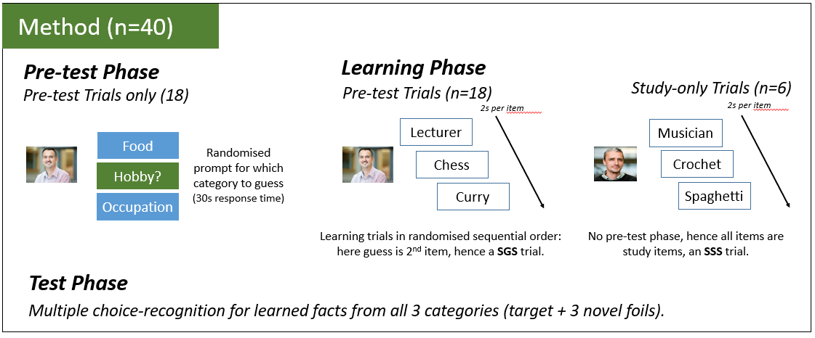
Images that provide information: Methods

Slide 52
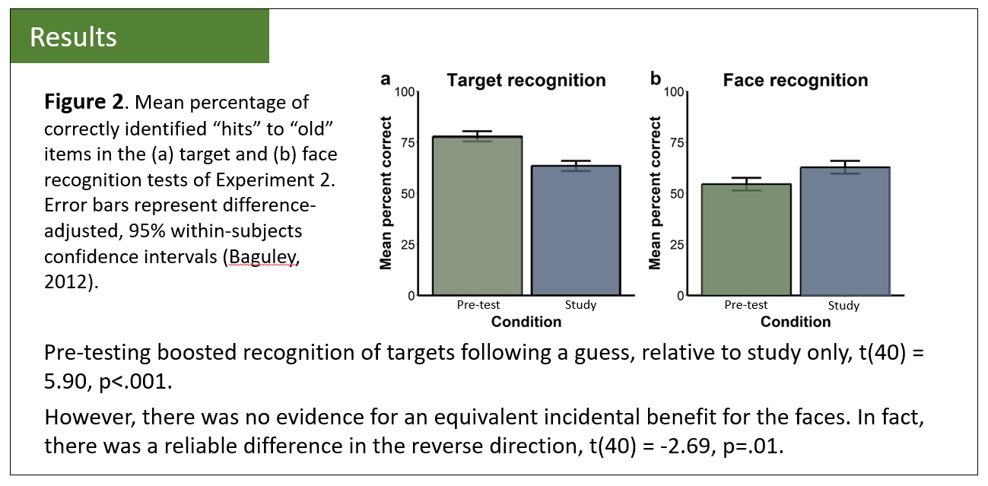
Images that provide information: Results

Slide 53

Images that increase engagement / aesthetics
These images don’t convey any information, but they do change how the poster is perceived

Slide 54
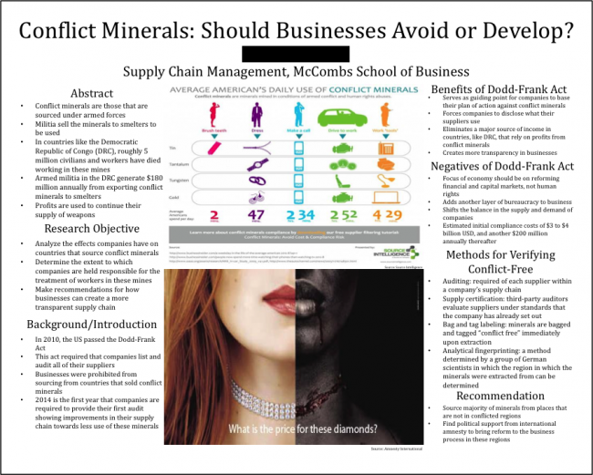
Images that increase engagement / aesthetics
Another powerful image (placed centrally for extra impact).

Slide 55


Images are essential for posters

Slide 56
4: For your poster: Images
Your poster must use images to display your findings.
A plot of the distribution of data
A plot of the means / a scatterplot.
You should also aim to use other images to
Explain the method
Increase the engagement / aesthetic appeal

Slide 57
2: Flow – how easy it is to follow a poster
Overall placement of sections
Have a scheme that is intuitively easy to follow.
If you need arrows, you have gone wrong.
Use spacing to break up sections / help the readability.

Slide 58
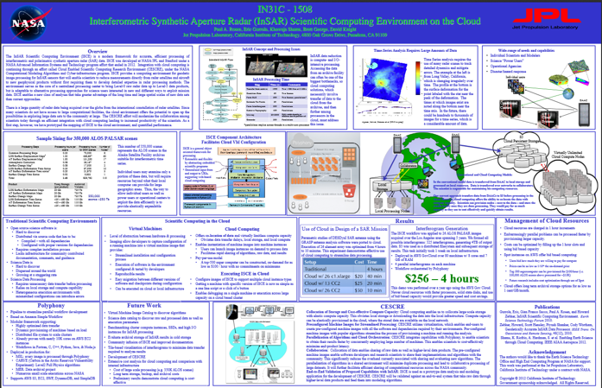
What poor flow / lack of space looks like….

Slide 59
Using space / avoid clutter: text boxes
Introduction
Guessing an answer to an unfamiliar question prior to seeing the answer leads to better memory than studying alone (the pre-testing effect), which has been attributed to increased curiosity about the answer. A similar effect occurs in general knowledge learning – people are more likely to recall answers to questions they are more curious about. Gruber and Ranganath (2019) argued that prediction errors cause a state of curiosity which improves the encoding of all information that is encountered during this state, including incidental information. If pre-testing similarly induces curiosity then it too should extend to better memory for incidental material. In our study participants guessed a categorical fact about an unfamiliar person (e.g. their hobby) before seeing the answer and two other facts (e.g. their occupation and favourite food) presented sequentially in different orders. Our prediction was that guessing should boost memory for the incidental facts only when they were presented before the answer.
Introduction
Guessing an answer to an unfamiliar question prior to seeing the answer leads to better memory than studying alone (the pre-testing effect), which has been attributed to increased curiosity about the answer. A similar effect occurs in general knowledge learning – people are more likely to recall answers to questions they are more curious about.
Gruber and Ranganath (2019) argued that prediction errors cause a state of curiosity which improves the encoding of all information that is encountered during this state, including incidental information. If pre-testing similarly induces curiosity then it too should extend to better memory for incidental material.
In our study participants guessed a categorical fact about an unfamiliar person (e.g. their hobby) before seeing the answer and two other facts (e.g. their occupation and favourite food) presented sequentially in different orders.
Our prediction was that guessing should boost memory for the incidental facts only when they were presented before the answer.

Slide 60
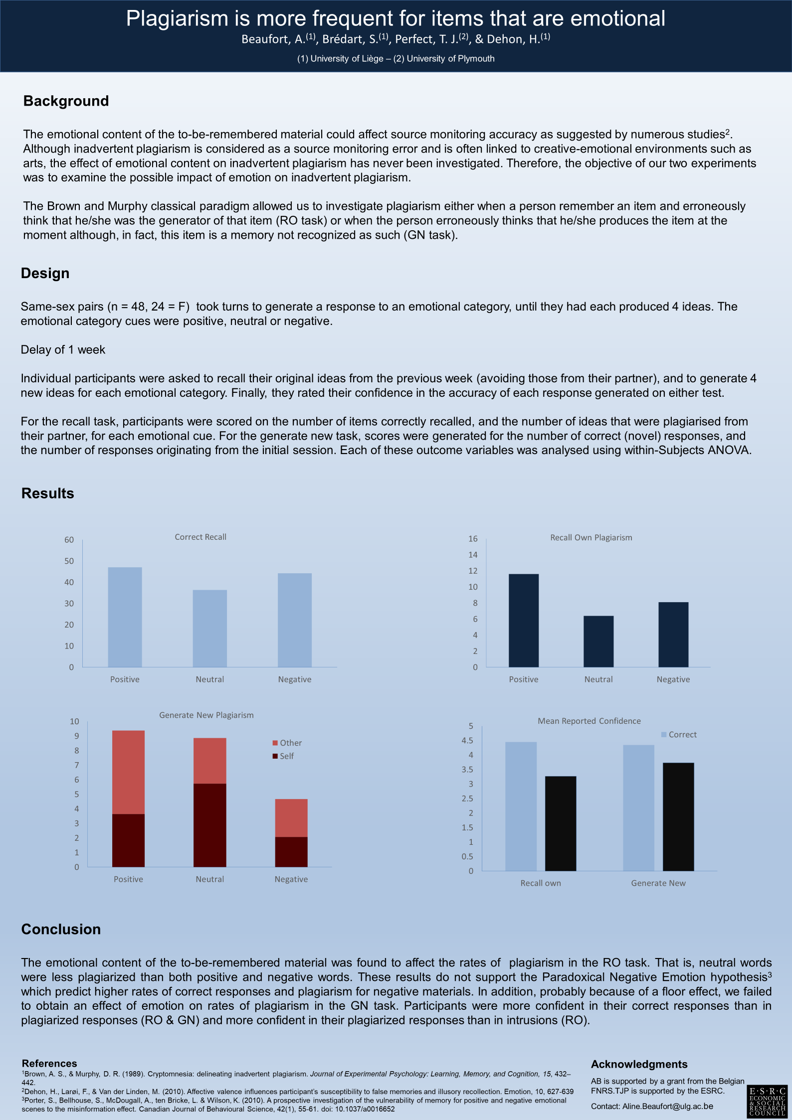
Using focal points of attention: highlighting

Slide 61
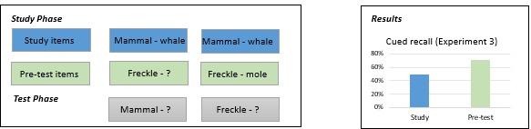
Helping the reader by linking concepts / conditions / groups

Slide 62
4: For your poster: Putting it all together
Here I have covered the content, and some of the principles behind a good scientific poster.
Your group poster will be judged on:
1: The scientific content
2: How engaging / well-designed it is.
3: How well you present it and answer questions about it.
You will learn HOW to make a poster in the workshops.

